Slide 1
Mobile Based Data Retrieval using RDF and NLP in an Efficient Approach
Name:Ananna Acharjee
ID:20101294

Slide 2
Introduction
Due to the influence of the White and Green Revolutions, as well as the increased availability of imported FMCG products, we have moved away from traditional farming methods and toward a more automated and medicated lifestyle. We suggest using ontology-based repositories and the SPARQL query language to enable effective data retrieval while documenting real-time farming experiences and thoughts in order to close the generational divide between farmers and current farmers. The article highlights a comprehensive strategy for raising a healthier generation by outlining modules like New Farmer Registration, Soil Testing, Suggested Plants, Inter Crop Pest Information, Weather Reports, and Marketing. Sections on comparable work, the suggested methodology, the architectural flow, the technology utilized, the outcomes, the conclusion, and online references are all included in the framework.

Slide 3
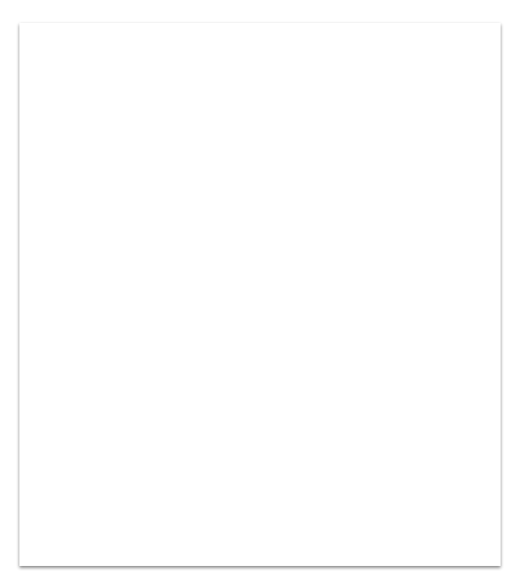
Proposed Approach
The methodology entails creating a mobile application specifically for agriculture that leverages natural language processing (NLP) to query owl files using SPARQL for optimal solutions. Data is transformed into ontology-based repositories (OWL and RDF) to enable rapid semantic querying.
Large datasets are stored by the system in these repositories, guaranteeing quick and easy retrieval of semantic data.
The system also develop a farmer-guiding smartphone app that provides timely guidance from planting to harvesting. It offers real-time market information for certain crops along with planting suggestions based on soil conditions and insights into plant growth.

Slide 4
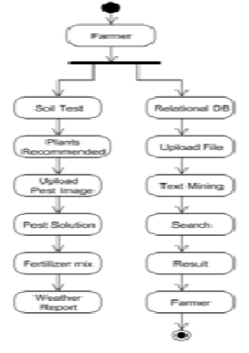
Architecture Flow

Slide 5
NLP bridges the computer-human gap by converting database queries into meaningful formats, enabling semantic analysis; the system employs WordNet Processing to identify semantic similarities in the dataset's words, grouping them with the word of interest.
Jean API is the boom for mobile application development.
Java support.
Handset-layouts.
My SQL.
Tomcat application server.
Android studio.

Slide 6
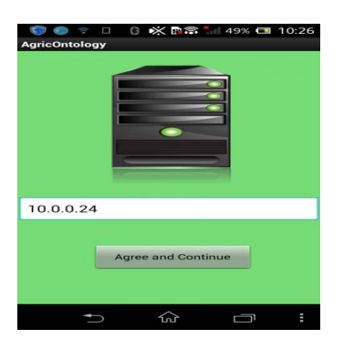
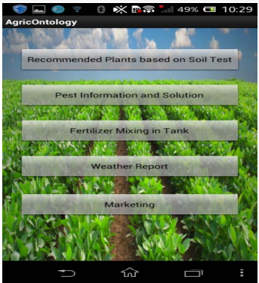
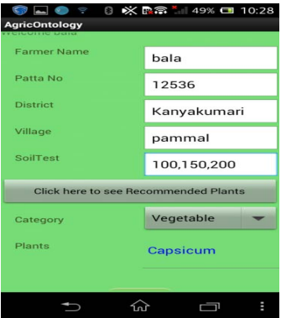
Results
FIG1:Home Screen FIG2:Mobile APP mobile screen FIG3:Recommended vegetable screen

Slide 7
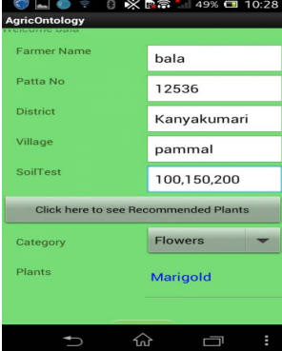
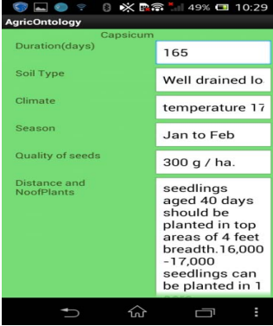
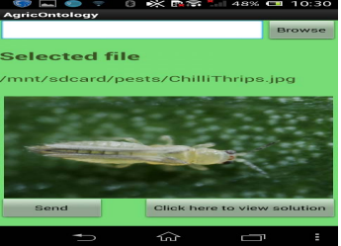
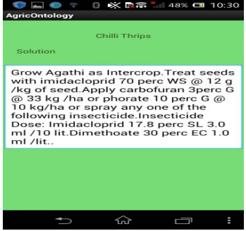
Results (Contd.)
FIG4:Recommended flower screen FIG5:Intercrop Soln scrn1 FIG6:Insects uploaded screen FIG7:Intercrop soln scrn2

Slide 8
Conclusion
Examined techniques and created a mobile application that helps close the gap between newcomers and farmers in the field of farming

